Slide 1
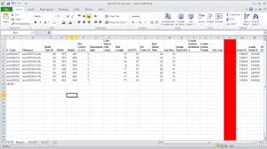
Microsoft Excel Tutorials
Presented by Yujia Zhang and Alexis Bennett
1. https://images.app.goo.gl/eEQYYB5qicV7ELGF6
https://images.app.goo.gl/wfr9w6PD3NaoW3TB9
USC Mark and Mary Stevens Neuroimaging and Informatics Institute
USC Laboratory of Neuroimaging
loni.usc.edu

Slide 2
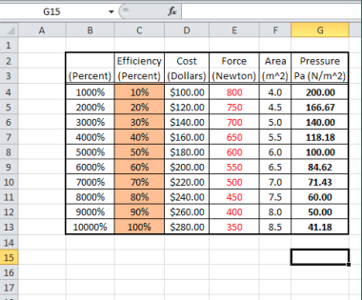
BASICS
Spreadsheet Usages:
When to use:?
Performing the same calculations repeatedly
Working with tabular information, column or row format
Producing graphs and other plot
Presenting results in a readable format

Slide 3
Applications
BUSINESS
ENGINEERING
Time value of money
Pie and bar chart
Other options for built-in functions such as rates of return, etc
X-Y plotting
Built-in functions
STATISTICS
Data Analysis
Regression, Curve fitting
Other options for built-in functions
USC Mark and Mary Stevens Neuroimaging and Informatics Institute
USC Laboratory of Neuroimaging
loni.usc.edu

Slide 4
BASICS
Terminology:
Worksheet: One page of spreadsheet document
Tabs at the bottom indicate the worksheet name
You can change the name by double clicking it
Cell: One block within the worksheet
Can insert data or formulas
Change color, size and border of each cell
Arrange in vertical columns and horizontal rows
Columns A – XFD, total of 16,384
Rows 1 – 1,048,576
USC Mark and Mary Stevens Neuroimaging and Informatics Institute
USC Laboratory of Neuroimaging
loni.usc.edu

Slide 5
Arithmetic Operation
It can be used as a calculator to perform arithmetic
Any cell using a formula must start with an = sign
The = sign indicates the following characters are a formula
In order to calculate, hit ENTER after the equation
A formula cells contains the formula, but it only display the numerical result
The numerical answer will appear in the cell
The equation can be seen in the formular bar
USC Mark and Mary Stevens Neuroimaging and Informatics Institute
USC Laboratory of Neuroimaging
loni.usc.edu

Slide 6
Arithmetic Operation
Calculation operators: + - * / ^
Use parenthesis to group operations
= (3+4)/2 will yield 3.5
= 3+4/2 will yield 5
For exponentials using ^ : 2^2 will yield 4
May refer to other cells within the worksheet,
If A2=5 & B2=3, then C2=A2*B2 will yield 15
C2 is known as a dependent cell
USC Mark and Mary Stevens Neuroimaging and Informatics Institute
USC Laboratory of Neuroimaging
loni.usc.edu

Slide 7
Functions
Used to perform simple or complex calculations
The most frequent are: SUM, AVERAGE, SQRT
Examples: = SUM(A2:A8) adds range A2 through A8
= AVERAGE(A2:A8) average values
= SQRT(A2) take square root of A2
Other functions: ABS, COS, SIN, EXP ….
USC Mark and Mary Stevens Neuroimaging and Informatics Institute
USC Laboratory of Neuroimaging
loni.usc.edu

Slide 8
Formatting Cells
It is important to use labels and units for all constants and formulas in Excel
Select the group of cells you want to format
Right-click and select format cells
Many format options:
Specify decimal places
Currencies
Time/Date
USC Mark and Mary Stevens Neuroimaging and Informatics Institute
USC Laboratory of Neuroimaging
loni.usc.edu

Slide 9
Organizing Your Data for Analysis
Want to make sure others can understand and easily use your data
A few standard practices:
Keep similar data in each column, with variable name in the first row
Use short, but descriptive variable names
Put only one entry in each cell
Be consistent!
Ex. ‘male’, ‘Male’, “Male “, and ‘M’ may seem like the same thing, but it makes a big difference when analyzing data
USC Mark and Mary Stevens Neuroimaging and Informatics Institute
USC Laboratory of Neuroimaging
loni.usc.edu

Slide 10
Messy Data vs. Clean Data Exercise
What are some things that we could do to make this data sheet look better?

Slide 11
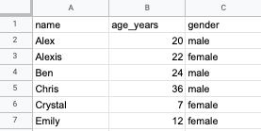
Messy Data vs. Clean Data Exercise
Better variable names
Data sorted by columns, not by rows
Data entry names are consistent

Slide 12
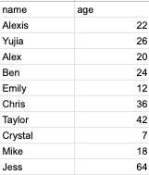
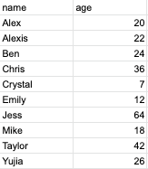
Sorting Data
Excel can sort your data for you so that you don’t have to do it by hand
Alphabetical or numerical order
Highlight group of cells you want to sort
Go to Data at the top of your sheet
Select Sort range
Can sort by one column, or add multiple columns of data you want to sort
USC Mark and Mary Stevens Neuroimaging and Informatics Institute
USC Laboratory of Neuroimaging
loni.usc.edu

Slide 13
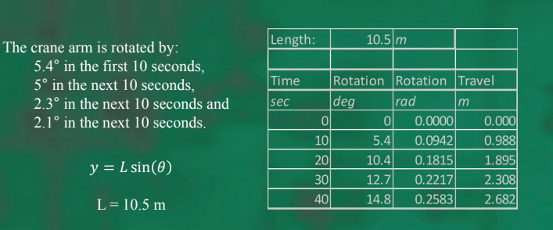
Absolute vs Relative Addressing
Absolute cell referencing is used to keep a cell reference constant. It uses “$” before row or column
Example: $B$20 is absolute
B20 is relative

Slide 14
Formatting Plots
It is important to be labeled with a title, axes, name and units

Slide 15
Goal Seek
Solves algebraic equations
If you know the result you want a formula to produce, you can use goal seek to determine the value of a cell on which formula depends
Back-calculates through multiple formulas in the sheet
Found under Data – What-if Analysis – Goal Seek
Set cell - Reference to the cell that contains the formula you want to solve
To value – Value you want from formula
By changing – Reference to the cell that contains the variable you want to adjust (this is the value you are finding)

Slide 16
IF Function
Logical test
General form = IF (Logical_test, value_if_true, value_if_false)
Logical_test is made up of two expressions and a comparison oprator
value_if_true is the value you want excel to display if the logical test is true
value_if_false is the value you want excel to display if the logical test is false
Example: = IF(H1>40, 100, 0)
If the value in H1 is more than 40, then the value for this cell will be 100.
If the value in H1 is less than 40, then the value for this cell will be 0.

Slide 17
IF Function
Comparison operators:
=
<
>
<=
>=
<> Not equal to

Slide 18
Exporting your Data
Save your data as a plain text file
File -> Download -> Comma Separated Values (.csv)
CSV files can be imported into Excel to go back to spreadsheet view
Also easier to use when you need data for coding
(Broman & Woo, 2018)

Slide 19
Workshop

